Slide 1

Red Wine Quality​
Presenting by :
Jay Zade
Rutuja Shete
Vaishnavi Choudhari
© All rights reserved by Fireblaze Technologies Pvt. Ltd.

Slide 2
Exploratory Data Analysis on Red Wine Quality
Contents :
Introduction to EDA
Types of Data
Measure of Central Tendency ( Mean , Median, Mode )
Measure of Dispersion ( Range, Variance, Standard Deviation)
Measure of Position (Quartiles, IQR)
Skewness and Kurtosis
Outliers Treatment(Z-score , IQR)
© All rights reserved by Fireblaze Technologies Pvt. Ltd.

Slide 3
Introduction to EDA
Exploratory Data Analysis Is an approach to analyzing data.
Purpose of EDA
To check null values.
TO check assumptions associated with any model fitting or hypothesis test.
Create a list of outliers.
Find parameter estimators.
© All rights reserved by Fireblaze Technologies Pvt. Ltd.

Slide 4
Types Of Variable
Variable
Categorical
Numerical
Nominal
Ordinal
Interval
Ratio
© All rights reserved by Fireblaze Technologies Pvt. Ltd.

Slide 5
Quantitative (or Numerical) Variable
Quantitative (or Numerical) Variables Height, Weight, number of siblings of these variables yield numerical information (yield numerical measurements)
Quantitative Variable
Discrete Variable
Continuous Variable
© All rights reserved by Fireblaze Technologies Pvt. Ltd.

Slide 6
Measure Of Central Tendency
It describes a whole set of data with a single value that represents the centre of its distribution.
There are three main measures of central tendency: the mode, the median and the mean.
Mean : Average Value
Median : Middle Value
Mode : Most Frequent Value
© All rights reserved by Fireblaze Technologies Pvt. Ltd.

Slide 7
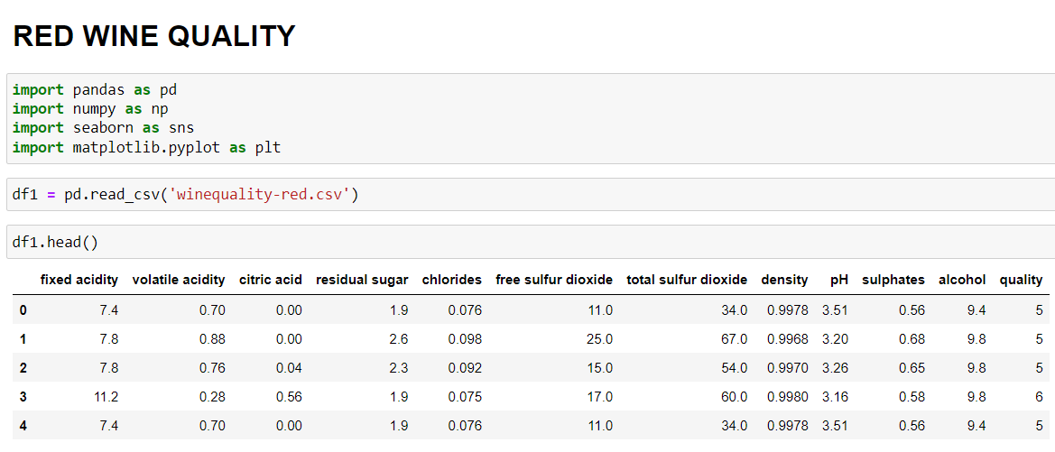
DATASET
© All rights reserved by Fireblaze Technologies Pvt. Ltd.

Slide 8
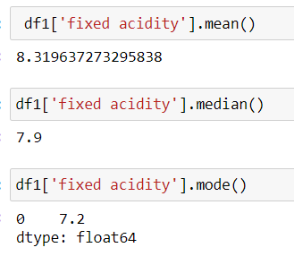
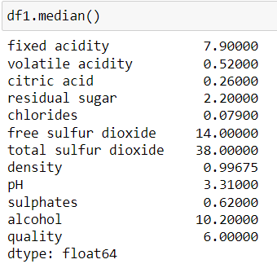
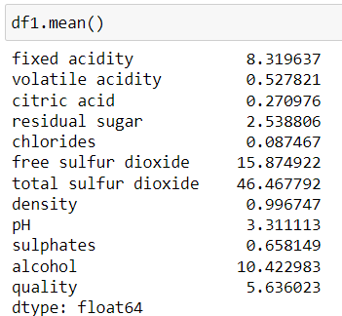
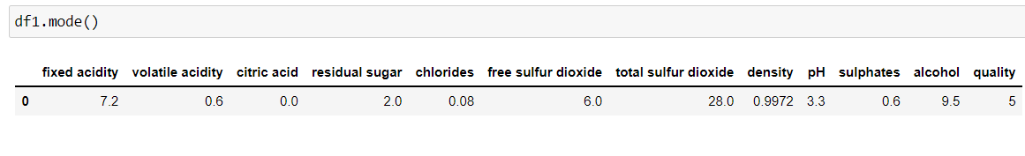
Measure Of Central Tendency (Example)
© All rights reserved by Fireblaze Technologies Pvt. Ltd.

Slide 9
Measure of Dispersion
Measure of Dispersion includes :-
Range :- It is a Difference between Maximum and Minimum value in a distribution. i.e.(Team1 → 2, 4, 10, 15, 24, 25, 40 → Range → 40 - 2 = 38 )
Standard Deviation: The Standard Deviation is a measure of how spread out numbers are.
Variance: The average of the squared differences from the Mean. i.e the Square of the Standard Deviation.
© All rights reserved by Fireblaze Technologies Pvt. Ltd.

Slide 10
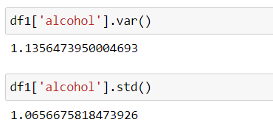
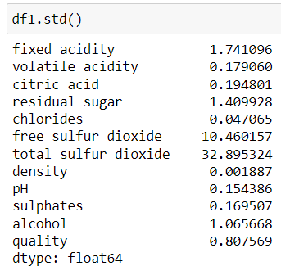
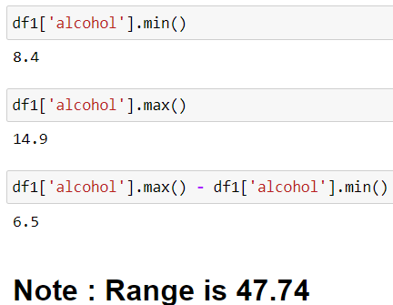
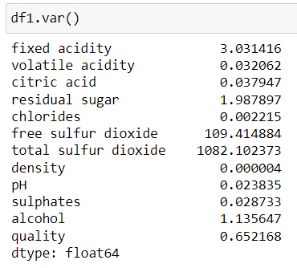
Measure of Dispersion (Example)
© All rights reserved by Fireblaze Technologies Pvt. Ltd.

Slide 11
Measure of Position
Measure of Position includes :-
Quartiles :-
Quartiles split the values into four equal parts.
The ‘First Quartile (Q1)’ divide the smallest 25% of the values from other 75%.
The ‘Second Quartile (Q2)’ is the median. 50% of the values are smaller than or equal and 50% are larger than or equal to the median.
The ‘Third Quartile (Q3)’ divide the smallest 75% of the values from larger 25%.
© All rights reserved by Fireblaze Technologies Pvt. Ltd.

Slide 12
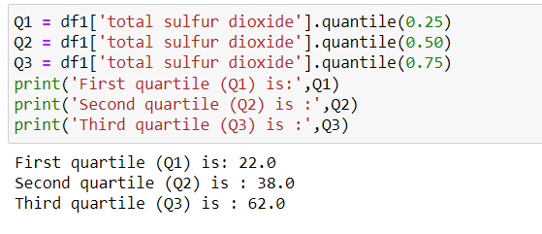
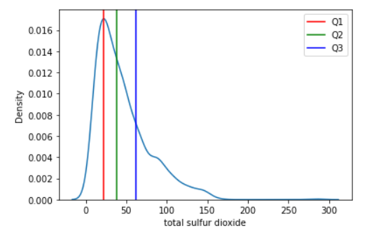
Quartiles(Example)
© All rights reserved by Fireblaze Technologies Pvt. Ltd.

Slide 13
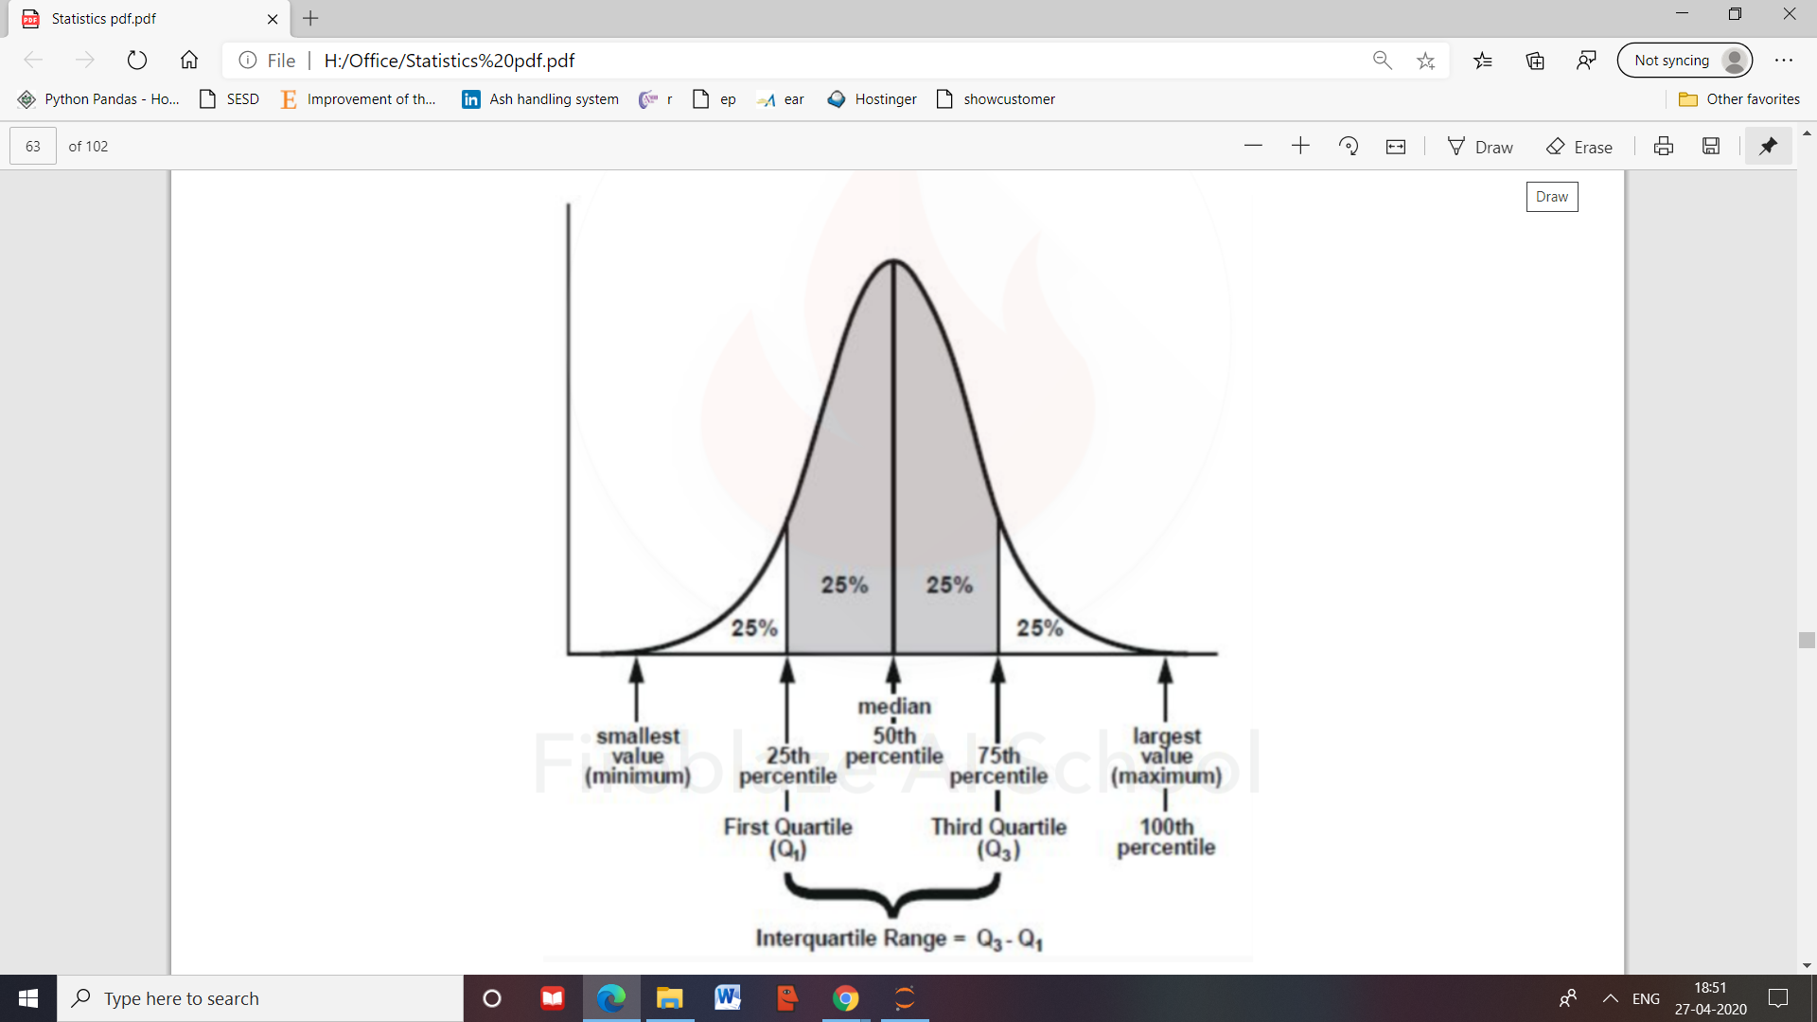

Measure of Position
2. Interquartile Range:
Also called as ‘midspread’.
Measure the difference in the center of a distribution between the third and first quartiles.
(IQR = Q3 – Q1)
IQR
© All rights reserved by Fireblaze Technologies Pvt. Ltd.

Slide 14
Skewness
Skewness measure the extent to which the data values are not ‘symmetrical’ around the mean.
There are three possibilities about skewness.
mean < median (Negative Skewness / Left skewed)
mean = median (symmetrical distribution)
mean > median (Positive skewness/ Right skewed)
In a skewed distribution there is an imbalance of data values ‘below & above’ the mean and skewness is a ‘non-zero’.
Less than ‘zero’ for a left-skewed distribution.
Greater than ‘zero’ for a right-skewed distribution.
© All rights reserved by Fireblaze Technologies Pvt. Ltd.

Slide 15
Skewness
Graphical Representation
Left Skewed
Symmetric
Right Skewed
© All rights reserved by Fireblaze Technologies Pvt. Ltd.

Slide 16
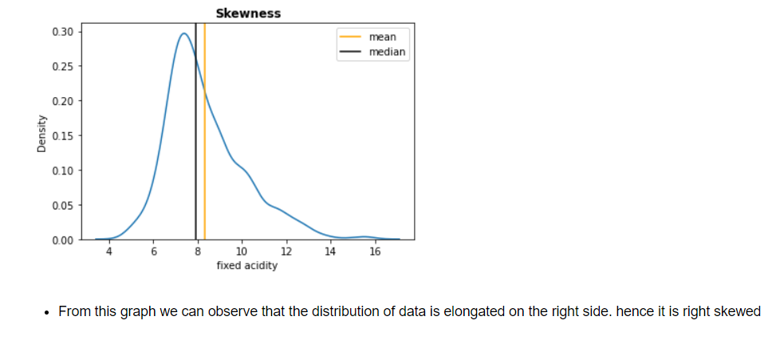
Skewness(Graphical Representation)
© All rights reserved by Fireblaze Technologies Pvt. Ltd.

Slide 17
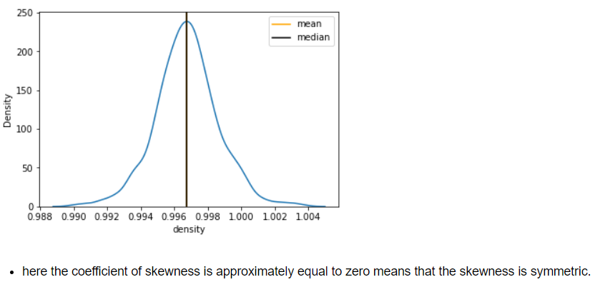
Skewness(Graphical Representation)
© All rights reserved by Fireblaze Technologies Pvt. Ltd.

Slide 18
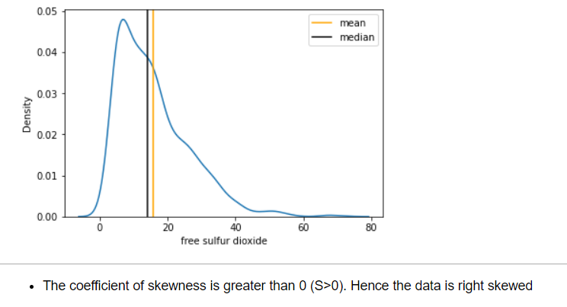
Skewness(Graphical Representation)
© All rights reserved by Fireblaze Technologies Pvt. Ltd.

Slide 19
Kurtosis
In statistics, kurtosis is defined as the parameter of relative sharpness of the peak of the probability distribution curve.
Compares the shape of the peak to the shape of the peak of a bell-shaped normal distribution.
It is used to indicate the Flatness or Peakedness of the frequency distribution curve and measures the tails or outliers of the distribution.
Types of Kurtosis:
Mesokurtic: A value is equal to zero called Mesokurtic
Leptokurtic : A value that is greater than zero called as ‘Leptokurtic’.
Platykurtic : A values is less than zero called ‘Platykurtic’.
© All rights reserved by Fireblaze Technologies Pvt. Ltd.

Slide 20
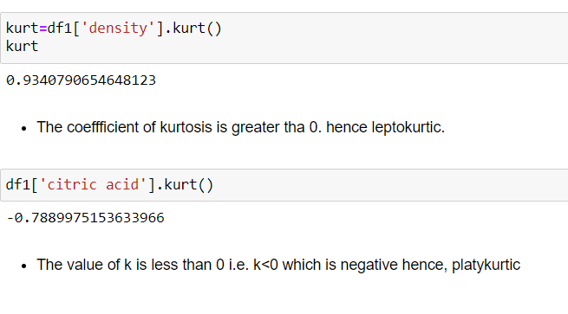
Kurtosis(Example)
© All rights reserved by Fireblaze Technologies Pvt. Ltd.

Slide 21
Outliers Treatment
Z Score or Standard Score:-
Z-score is the number of standard deviations from the mean a data point is.
(Z Score = (x - μ) / σ )
A z-score of zero tells you the values is exactly average while a score of +3 tells you that the value is much higher than average.
If a z-score is a +ve or -ve number, it indicates whether the value is above or below the mean and by how many standard deviations.
Z-score help identify ‘outliers’.
As general rule, a Z-score that is less than -3.0 or greater than +3.0 indicates as outlier value.
© All rights reserved by Fireblaze Technologies Pvt. Ltd.

Slide 22
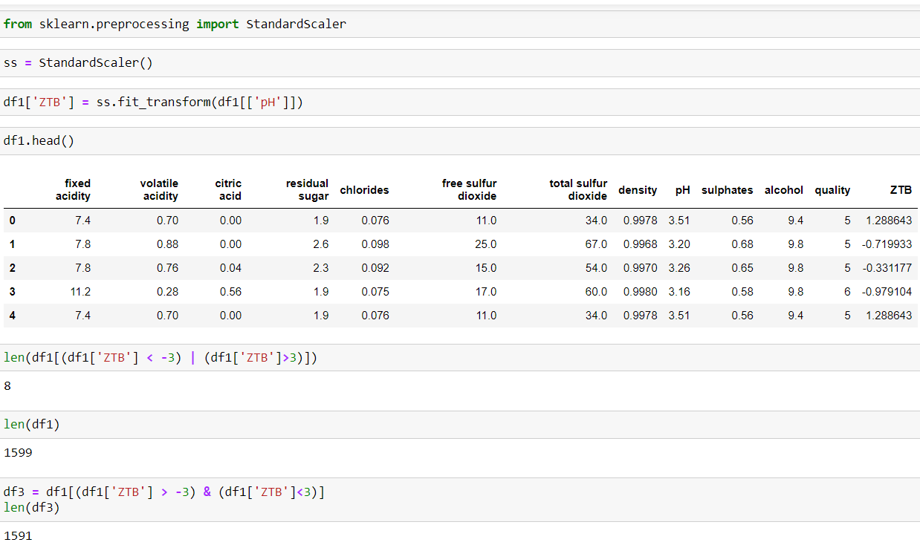
Z-Score(detecting Outliers)
© All rights reserved by Fireblaze Technologies Pvt. Ltd.

Slide 23
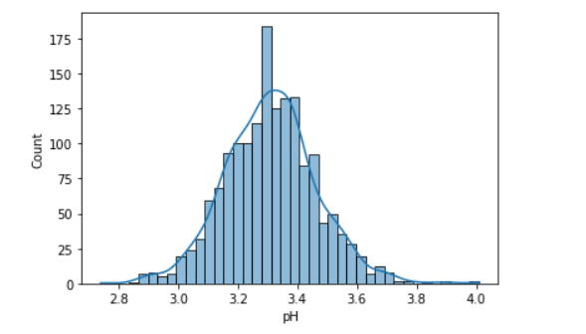
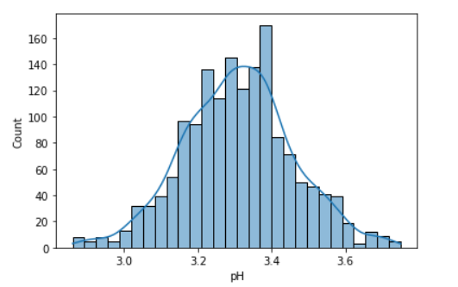
Graphical Representation
© All rights reserved by Fireblaze Technologies Pvt. Ltd.

Slide 24
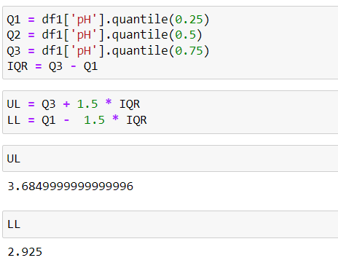
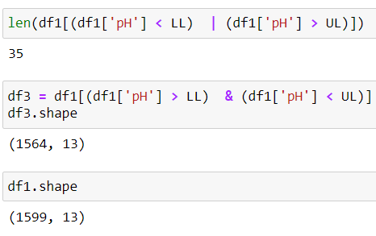
IQR(detecting Outliers)
To detect the outliers using this method, we define a new range, let’s call it decision range, and any data point lying outside this range is considered as outlier and is accordingly dealt with. The range is as given below:
Lower bound = (Q1 – 1.5*IQR)
Upper bound = (Q3 + 1.5*IQR)
Any data point less than the Lower Bound or more than the Upper Bound is considered as an outlier.
© All rights reserved by Fireblaze Technologies Pvt. Ltd.

Slide 25
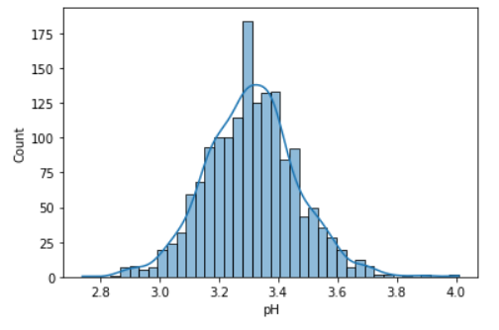
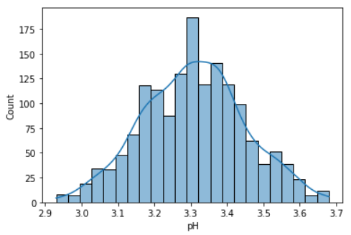
Graphical Representation
© All rights reserved by Fireblaze Technologies Pvt. Ltd.

Slide 26
!!! THANK YOU !!!
© All rights reserved by Fireblaze Technologies Pvt. Ltd.

